Slide 2
Well done for making it to the end of this room. To recap, we’ve learned about the following elements of command injection:
How to discover the command injection vulnerability
How to test and exploit this vulnerability using payloads designed for different operating systems
How to prevent this vulnerability in an application
Applying your learning by performing command injection in a practical application

Slide 3
Command injection is the abuse of an application's behaviour to execute commands on the operating system, using the same privileges that the application on a device is running with. For example, achieving command injection on a web server running as a user named joe will execute commands under this joe user - and therefore obtain any permissions that joe has.
A command injection vulnerability is also known as a "Remote Code Execution" (RCE)
Because an attacker can trick the application into executing a series of payloads that they provide, without direct access to the machine itself (i.e. an interactive shell). The webserver will process this code and execute it under the privileges and access controls of the user who is running that application.
Because of the ability to remotely execute code within an application.
For example, being able to abuse an application to perform the command whoami to list what user account the application is running will be an example of command injection

Slide 4
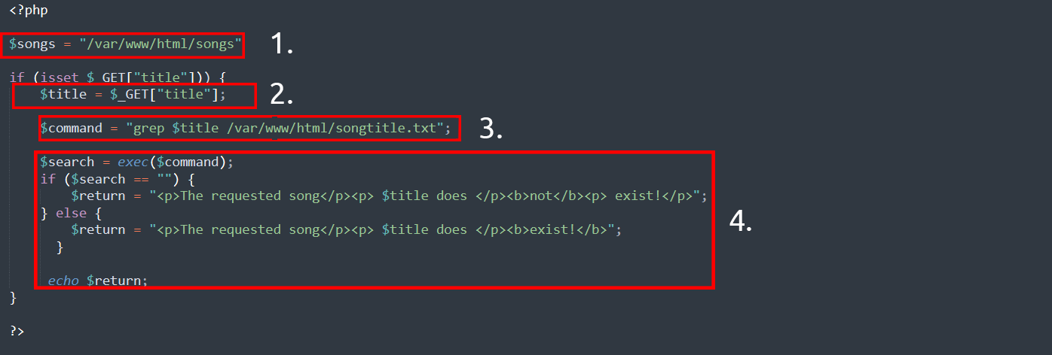
Discovering Command Injection
This vulnerability exists because applications often use functions in programming languages such as PHP, Python and NodeJS to pass data to and to make system calls on the machine’s operating system. For example, taking input from a field and searching for an entry into a file.
The application takes data that a user enters in an input field name $titlet to search a directory for a song title. Let’s break this down into

Slide 5
1. The application stores MP3 files in a directory contained on the operating system.
2. The user inputs the song title they wish to search for. The application stores this input into the $title variable.
3. The data within this $title variable is passed to the command grep to search a text file named songtitle.txt for the entry of whatever the user wishes to search for.
4. The output of this search of songtitle.txt will determine whether the application informs the user that the song exists or not.
Now, this sort of information would typically be stored in a database; however, this is just an example of where an application takes input from a user to interact with the application’s operating system.
An attacker could abuse this application by injecting their own commands for the application to execute. Rather than using grep to search for an entry in songtitle.txt, they could ask the application to read data from a more sensitive file.
Abusing applications in this way can be possible no matter the programming language the application uses. As long as the application processes and executes it, it can result in command injection. For example, this code snippet below is an application written in Python.

Slide 6
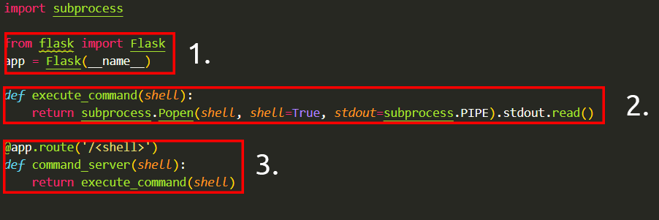
Helo
The "flask" package is used to set up a web server
A function that uses the "subprocess" package to execute a command on the device
We use a route in the webserver that will execute whatever is provided. For example, to execute whoami, we'd need to visit http://flaskapp.thm/whoami

Slide 7
Exploiting Command Injection
Applications that use user input to populate system commands with data can often be combined in unintended behaviour. For example, the shell operators ; , & and && will combine two (or more) system commands and execute them both.
Command Injection can be detected in mostly one of two ways:
Blind command injection
Verbose command injection
Blind | This type of injection is where there is no direct output from the application when testing payloads. You will have to investigate the behaviours of the application to determine whether or not your payload was successful.
Verbose | This type of injection is where there is direct feedback from the application once you have tested a payload. For example, running the whoami command to see what user the application is running under. The web application will output the username on the page directly.

Slide 8
Detecting Blind Command Injection
Blind command injection is when command injection occurs; however, there is no output visible, so it is not immediately noticeable. For example, a command is executed, but the web application outputs no message.
For this type of command injection, we will need to use payloads that will cause some time delay. For example, the ping and sleep commands are significant payloads to test with. Using ping as an example, the application will hang for x seconds in relation to how many pings you have specified.
Another method of detecting blind command injection is by forcing some output. This can be done by using redirection operators such as >. For example, we can tell the web application to execute commands such as whoami and redirect that to a file. We can then use a command such as cat to read this newly created file’s contents.
[[[Testing command injection this way is often complicated and requires quite a bit of experimentation, significantly as the syntax for commands varies between Linux and Windows.]]]
The curl command is a great way to test for command injection. This is because you are able to use curl to deliver data to and from an application in your payload. Take this code snippet below as an example,
curl http://vulnerable.app/process.php%3Fsearch%3DThe%20Beatles%3B%20whoami

Slide 9
Detecting Verbose Command Injection
Detecting command injection this way is arguably the easiest method of the two. Verbose command injection is when the application gives you feedback or output as to what is happening or being executed.
For example, the output of commands such as ping or whoami is directly displayed on the web application.
Useful payloads::linux
whoami | See what user the application is running under.
ls | List the contents of the current directory. You may be able to find files such as configuration files, environment files (tokens and application keys), and many more valuable things.
ping | This command will invoke the application to hang. This will be useful in testing an application for blind command injection.
sleep | This is another useful payload in testing an application for blind command injection, where the machine does not have ping installed
nc | Netcat can be used to spawn a reverse shell onto the vulnerable application. You can use this foothold to navigate around the target machine for other services, files, or potential means of escalating privileges.

Slide 10
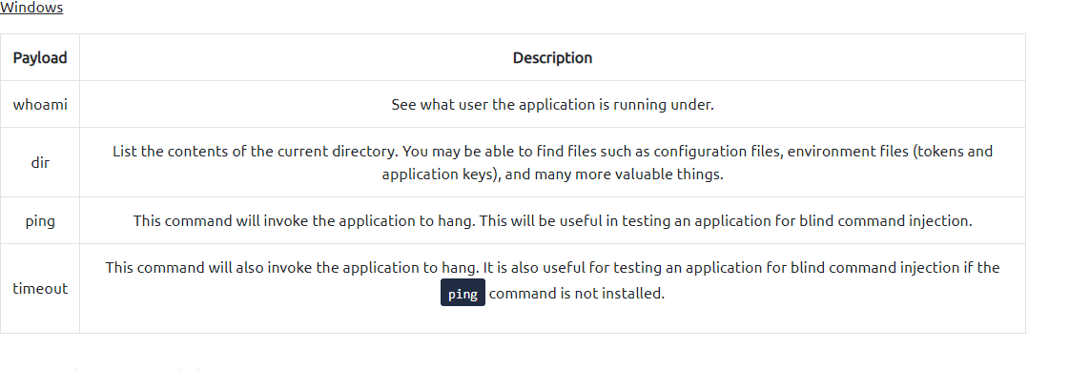

Slide 11
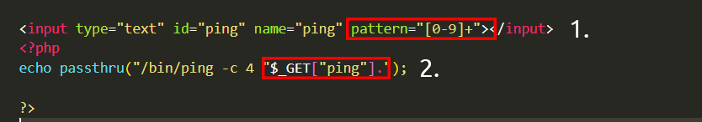
Remediating Command Injection
Command injection can be prevented in a variety of ways. Everything from minimal use of potentially dangerous functions or libraries in a programming language to filtering input without relying on a user’s input.
Vulnerable Functions
In PHP, many functions interact with the operating system to execute commands via shell; these include:
Exec
Passthru
System
Here, the application will only accept and process numbers that are inputted into the form. This means that any commands such as whoami will not be processed.
The application will only accept a specific pattern of characters (the digits 0-9)
The application will then only proceed to execute this data which is all numerical.

Slide 12
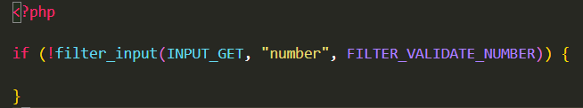

Input sanitisation
Sanitising any input from a user that an application uses is a great way to prevent command injection. This is a process of specifying the formats or types of data that a user can submit. For example, an input field that only accepts numerical data or removes any special characters such as > , & and /.
In the snippet below, the filter_input PHP function is used to check whether or not any data submitted via an input form is a number or not. If it is not a number, it must be invalid input.
Bypassing Filters
Applications will employ numerous techniques in filtering and sanitising data that is taken from a user's input. These filters will restrict you to specific payloads; however, we can abuse the logic behind an application to bypass these filters. For example, an application may strip out quotation marks; we can instead use the hexadecimal value of this to achieve the same result.
When executed, although the data given will be in a different format than what is expected, it can still be interpreted and will have the same result.

